Slide 1
Searching Algorithms
Finding elements in large amounts of data
Determine whether an array contains value matching key value
Linear search
Binary search

Slide 2
Searching an Array
Linear search
small arrays
unsorted arrays
Binary search
large arrays
sorted arrays

Slide 3
Linear Search Algorithm
Start at first element of array.
Compare value to value (key) for which you are searching
Continue with next element of the array until you find a match or reach the last element in the array.
Note: On the average we have to compare the search key with half the elements in the array.

Slide 4
Linear Search - Example
Array numlist contains:
Searching for the value 11:
linear search examines 17, 23, 5, and 11
Searching for the value 7:
linear search examines 17, 23, 5, 11, 2, 29, and 3
17 | 23 | 5 | 11 | 2 | 29 | 3

Slide 5
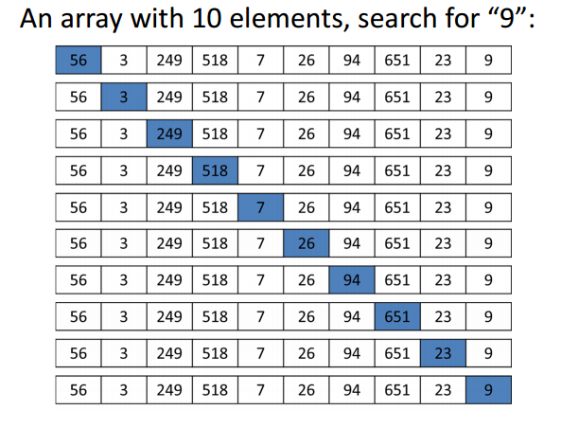
Linear Search

Slide 6
Linear Search
Algorithm:
set found to false; set position to –1; set index to 0
while index < number of elements. and found is false
if list[index] is equal to search value
found = true
position = index
end if
add 1 to index
end while
return position

Slide 7
A Linear Search Function
int searchList(int list[], int numElems, int value) { int index = 0; // Used as a subscript to search array int position = -1; // To record position of search value bool found = false; // Flag to indicate if value was found while (index < numElems && !found) { if (list[index] == value) // If the value is found { found = true; // Set the flag position = index; // Record the value's subscript } index++; // Go to the next element } return position; // Return the position, or -1 }

Slide 8
Simpler Linear Search: Psuedocode
function linearSearch(items, target)
for i from 0 to length – 1
if items[i] == target
return i
return not found

Slide 9
Linear Search: Java Implementation
public static int linearSearch(float[] items, float target) {
for (int index = 0; index < items.length; index++) {
if (items[index] == target) {
return index;
}
}
// element could not be found in the list
return -1;
}

Slide 10
Linear Search
Benefits:
Easy algorithm to understand
Array can be in any order
Disadvantages:
Inefficient (slow): for array of N elements, examines N/2 elements on average for value in array, N elements for value not in array

Slide 11
Binary Search Algorithm
May only be used on a sorted array.
Eliminates one half of the elements after each comparison.
Locate the middle of the array
Compare the value at that location with the search key.
If they are equal - done!
Otherwise, decide which half of the array contains the search key.
Repeat the search on that half of the array and ignore the other half.
The search continues until the key is matched or no elements remain to be searched.

Slide 12
Binary Search Example
a
search key = 19
0
1
2
3
4
5
6
7
8
9
10
11
12
1
5
15
19
25
27
29
middle of the array
compare a[6] and 19
19 is smaller than 29 so the next
search will use the lower half of the array
31
33
45
55
88
100

Slide 13
Binary Search Pass 2
a
search key = 19
0
1
2
3
4
5
1
5
15
use this as the middle of the array
Compare a[2] with 19
15 is smaller than 19 so use the top
half for the next pass
19
25
27

Slide 14
Binary Search Pass 3
search key = 19
3
4
5
a
19
use this as the middle of the array
Compare a[4] with 19
25 is bigger than 19 so use the bottom
half
25
27

Slide 15
Binary Search Pass 4
search key = 19
3
a
19
use this as the middle of the array
Compare a[3] with 19
Found!!

Slide 16
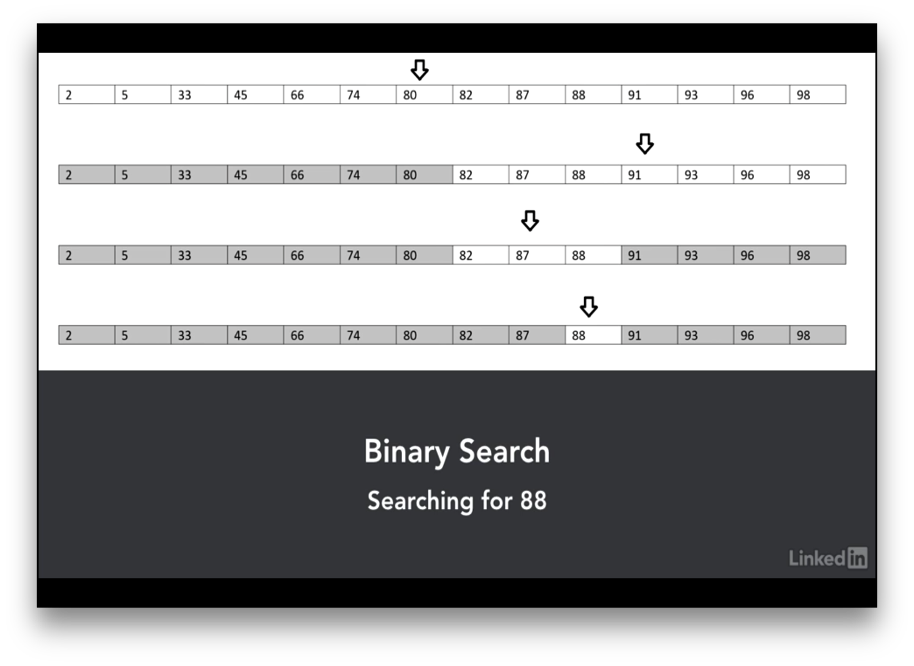
Binary Search

Slide 17
Efficiency
Searching and array of 1024 elements will take at most 10 passes to find a match or determine that the element does not exist in the array.
512, 256, 128, 64, 32, 16, 8, 4, 2, 1
An array of one billion elements takes a maximum of 30 comparisons.
The bigger the array the better a binary search is as compared to a linear search

Slide 18
Binary Search
Set first index to 0. Set last index to the last subscript in the array.
Set found to false. Set position to -1.
While found is not true and first is less than or equal to last
Set middle to the subscript half-way between array[first] and array[last].
If array[middle] equals the desired value
Set found to true.
Set position to middle.
Else If array[middle] is greater than the desired value
Set last to middle - 1.
Else
Set first to middle + 1.
End If.
End While.
Return position.

Slide 19
A Binary Search Function
int binarySearch(int array[], int size, int value) { int first = 0, // First array element last = size - 1, // Last array element middle, // Mid point of search position = -1; // Position of search value bool found = false; // Flag while (!found && first <= last) { middle = (first + last) / 2; // Calculate mid point if (array[middle] == value) // If value is found at mid { found = true; position = middle; } else if (array[middle] > value) // If value is in lower half last = middle - 1; else first = middle + 1; // If value is in upper half } return position; }

Slide 20
Thank You

